Slide 1
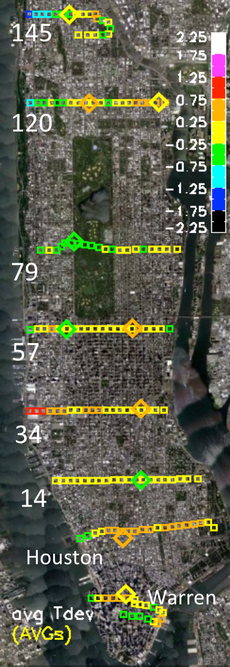
Do Small Elevation Differences Affect Urban Temperatures?
• Is air just naturally cooler at higher elevations?
• Do the surroundings change from top to bottom?
• Does greater exposure to wind have an effect?
Advisor: Dr Brian Vant-Hull

Slide 2
How Does Wind Affect Temperature?
• Sun heats surfaces above air temperature
• Wind cools upper elevations more than lower.

Slide 3
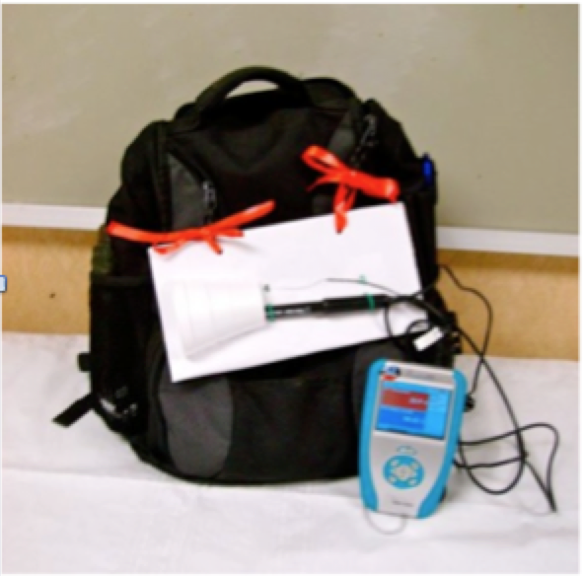
How do we find out?
Students will make repeated simultaneous temperature measurements at top and bottom of the Heights in several locations under different weather conditions.

Slide 4
Analysis Needed!
• Neighborhood characteristics such as vegetation, building density, etc will be assessed.
• Statistical analysis will determine contributors to temperature differences.
• Demographics will also be correlated to physical characteristics of the neighborhoods.

