Slide 1
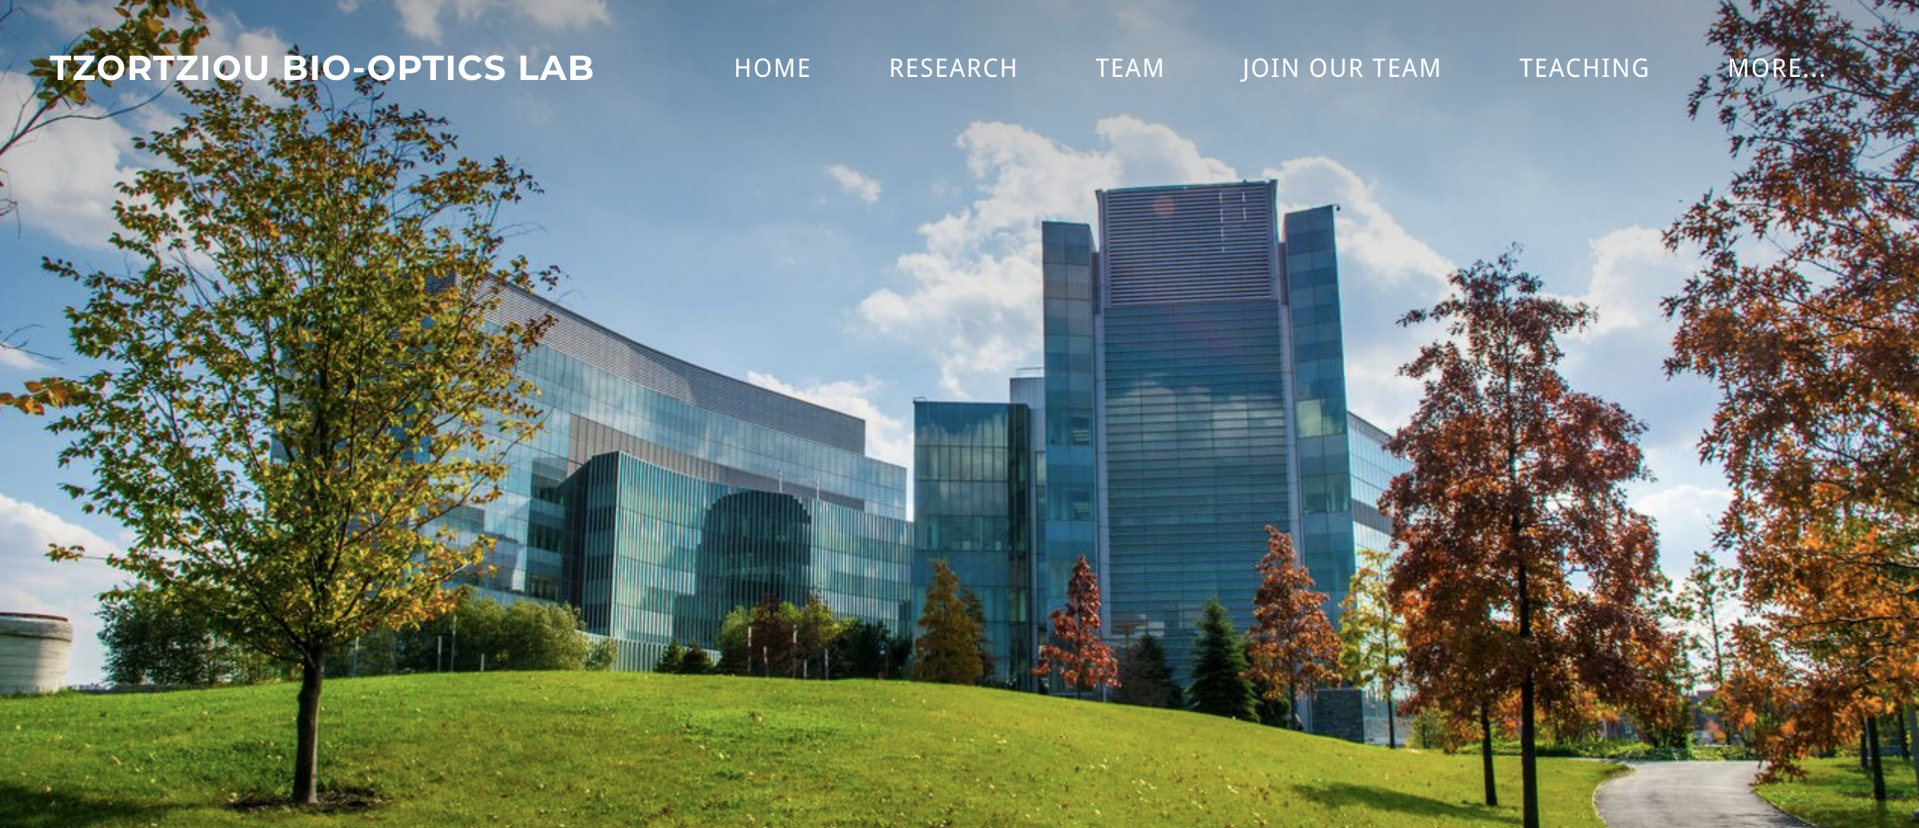
Carbon Cycling in the Yukon River
Principal Investigator: Dr. Maria Tzortziou
Graduate Mentor: Alana Menendez

Slide 2
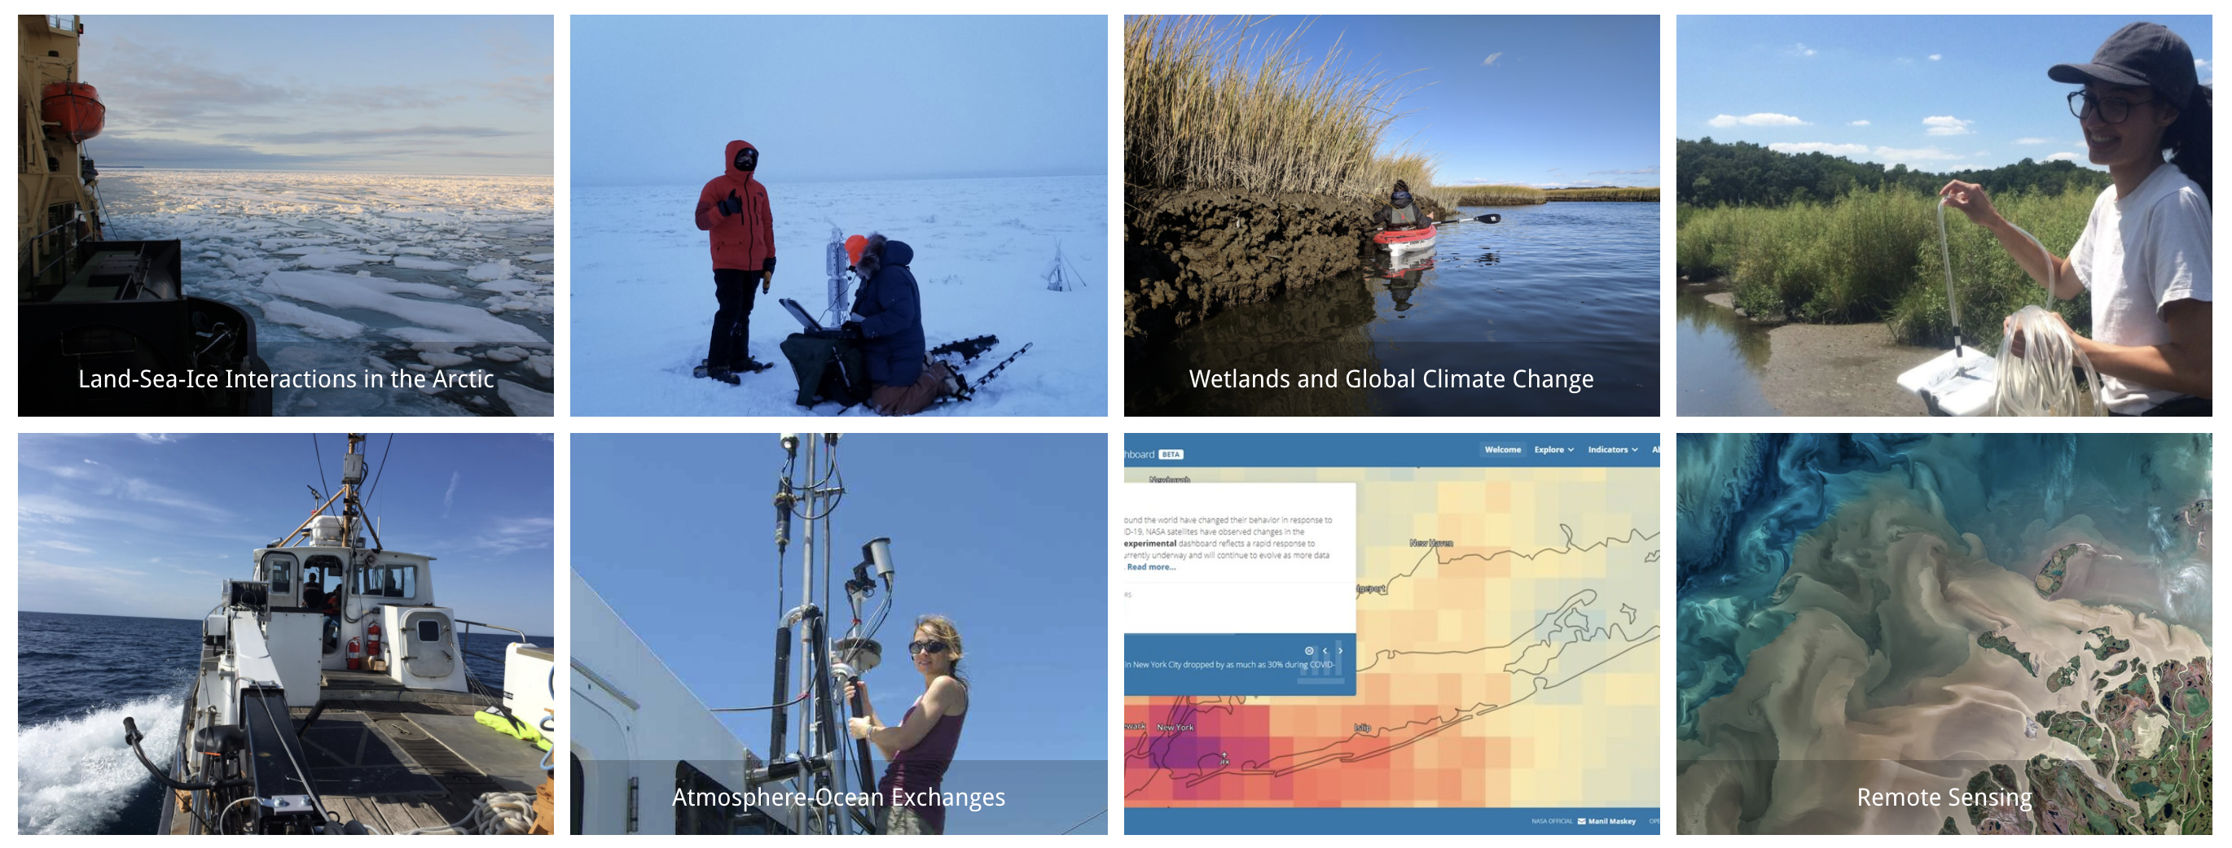
Tzortziou Lab Research Overview
Working across many ecosystems: Alaskan Arctic, Long Island Sound, Chesapeake Bay, Bay of Bengal
Integrating ground-based and satellite remote sensing tools tools and coupling with models
Partnering with relevant stakeholders, a key objective of our research is applying results to link science to practice and enhance decision support systems

Slide 3
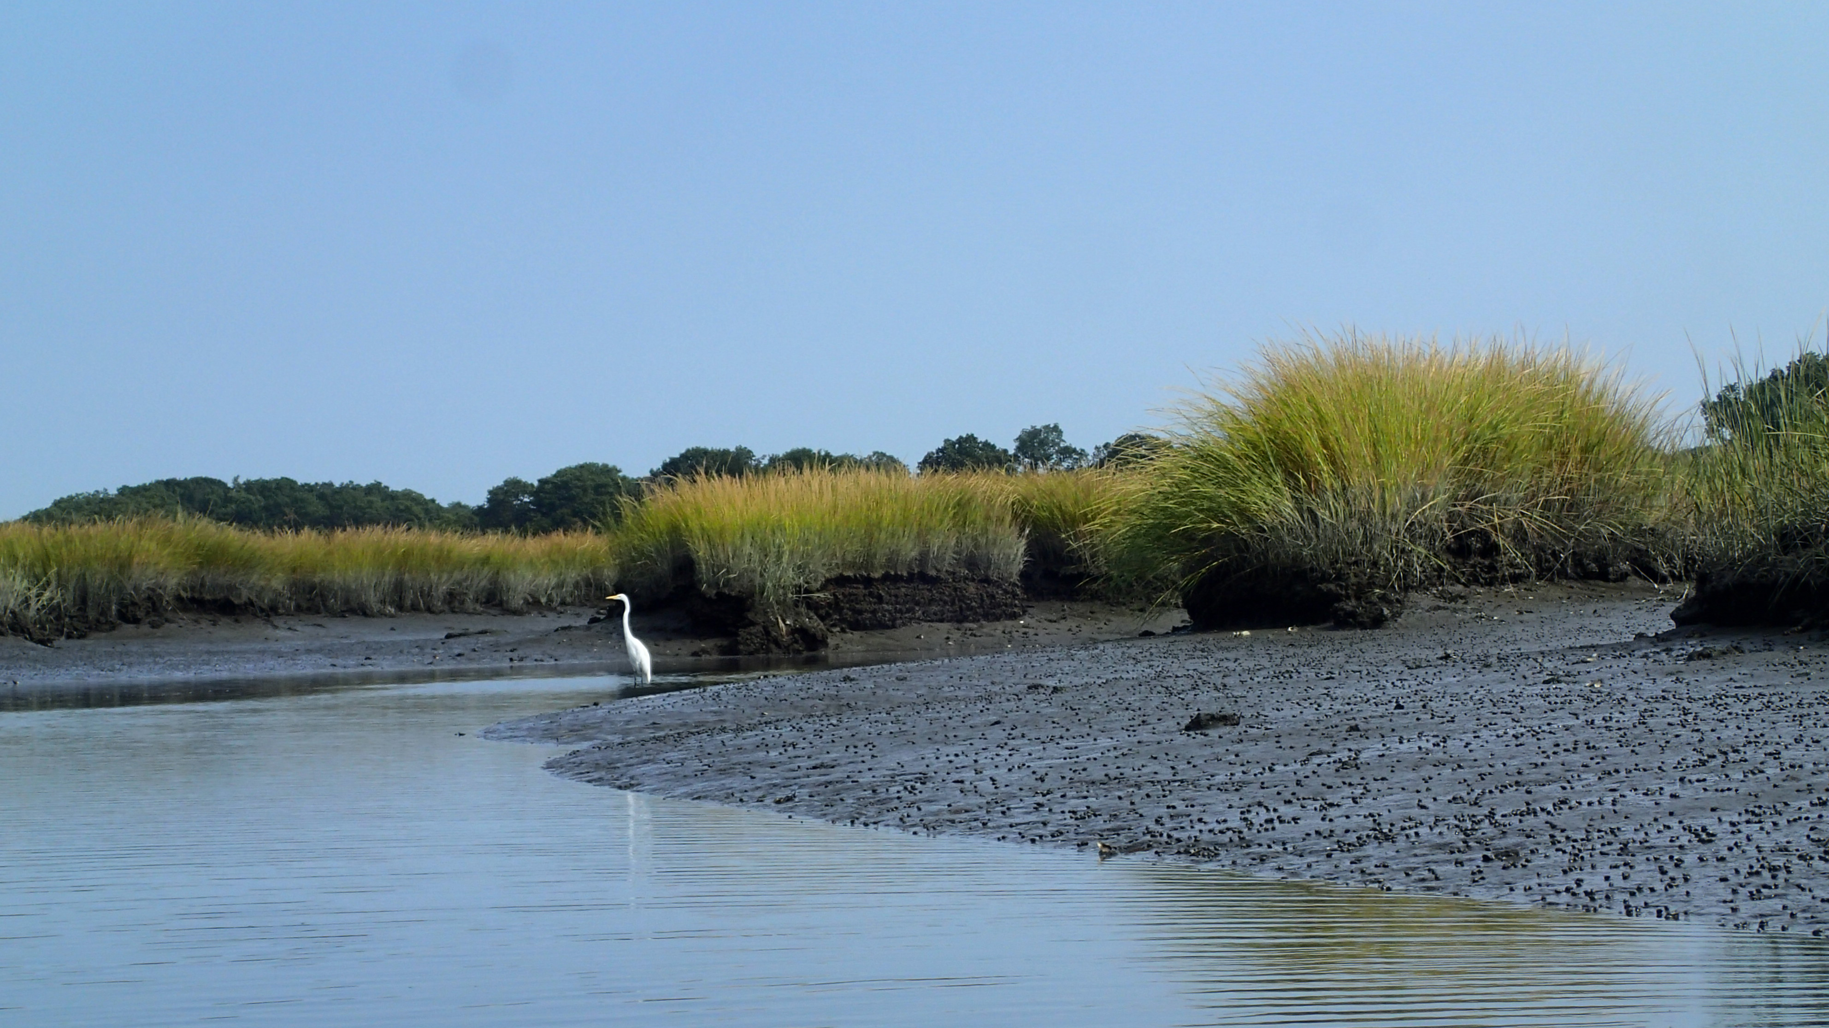
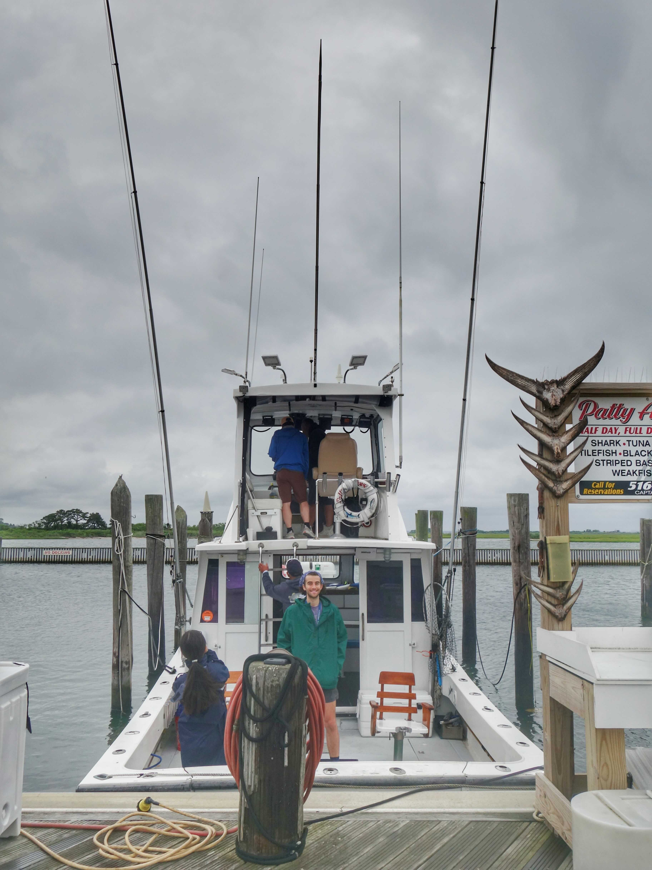
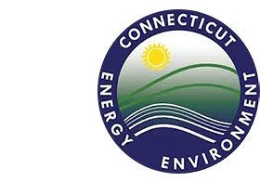
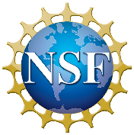
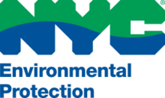
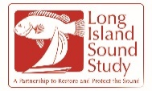
Summer Fieldwork Opportunity
Characterize flux of carbon and nutrients exported from natural systems (such as wetlands)
Understand, model, and predict the role of human activities (such as wastewater influences)
Coastal habitat, biogeochemical cycles, and global change

Slide 4
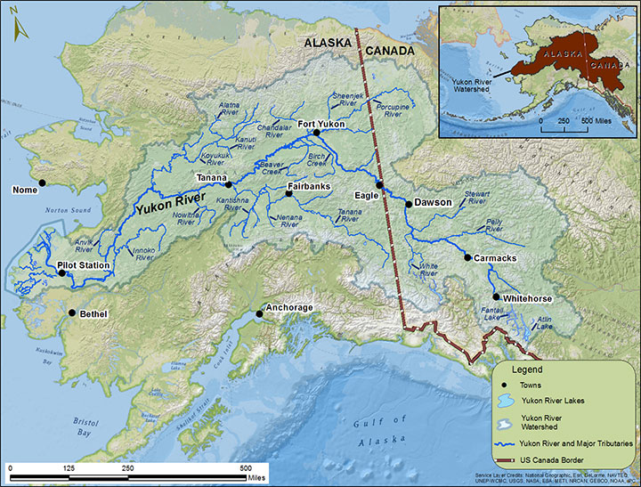
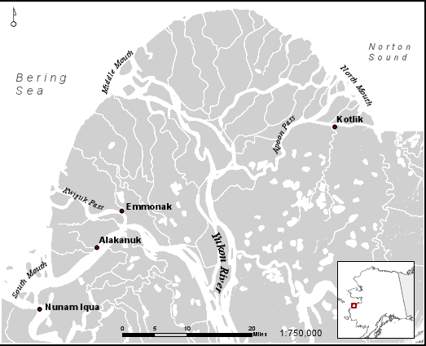
Summer Research Opportunity: Yukon River
Image Credit: Alaska Department of Fish & Game
Image Credit: ELOKA

Slide 5
Landsat-8 Image of the Yukon Delta

Slide 6
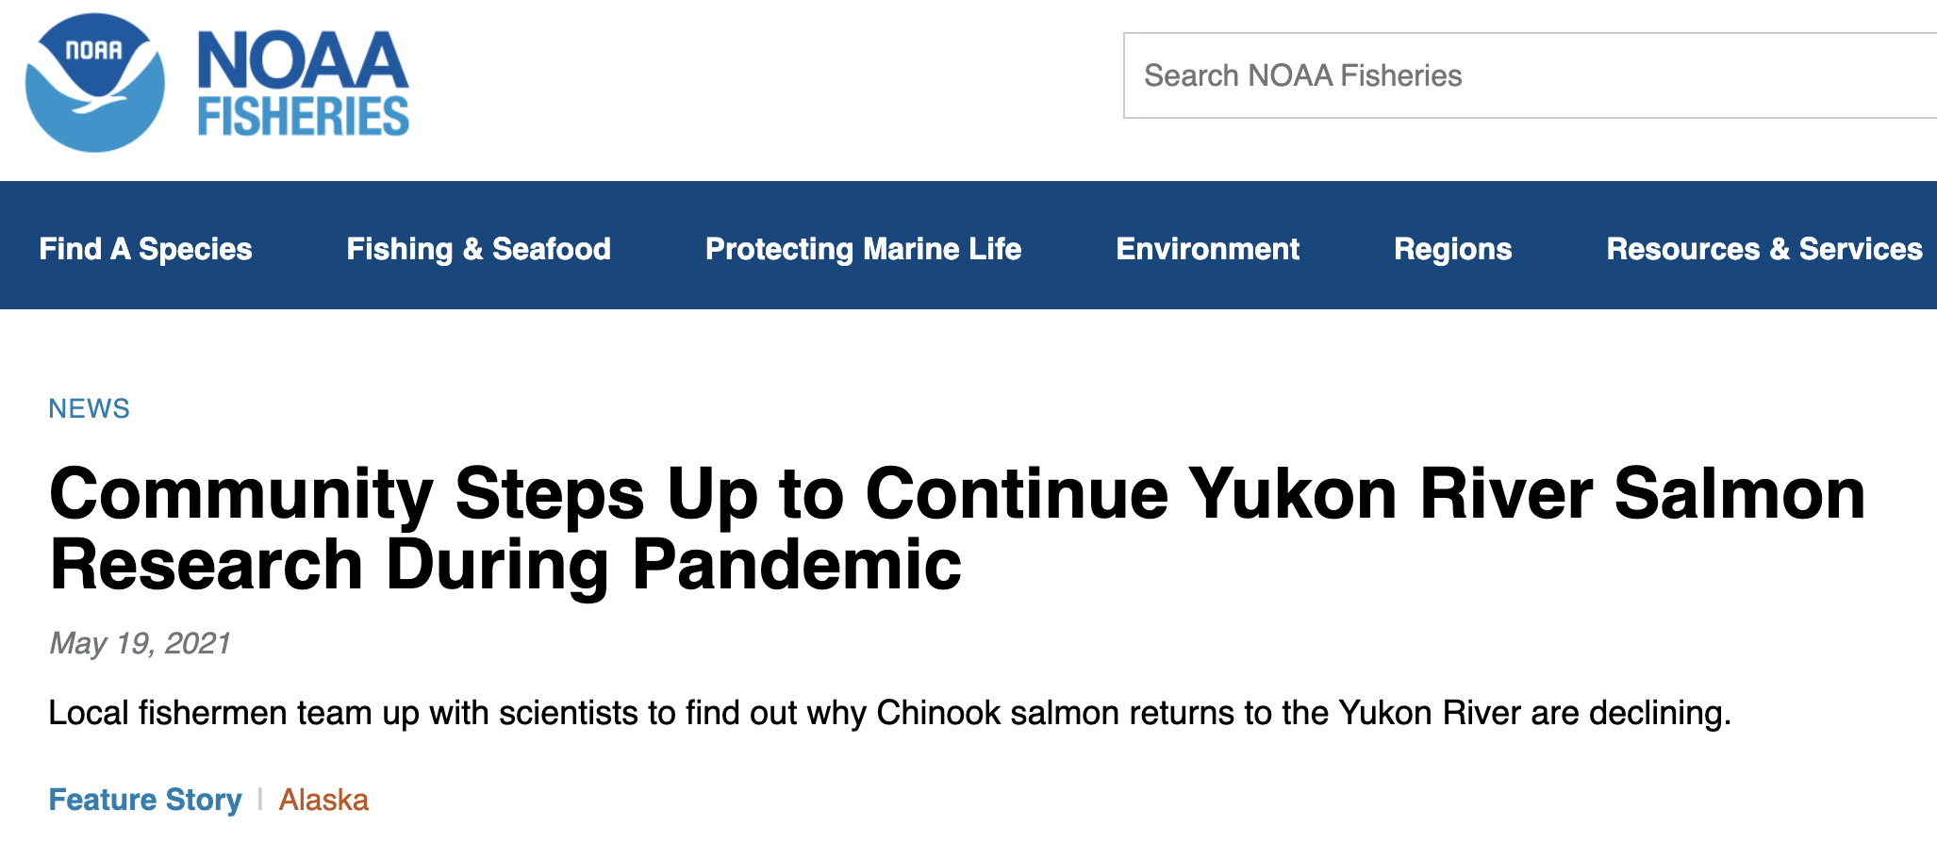
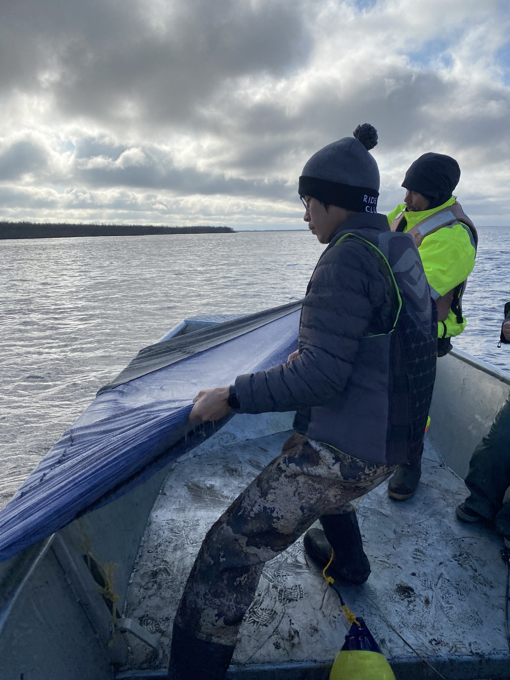
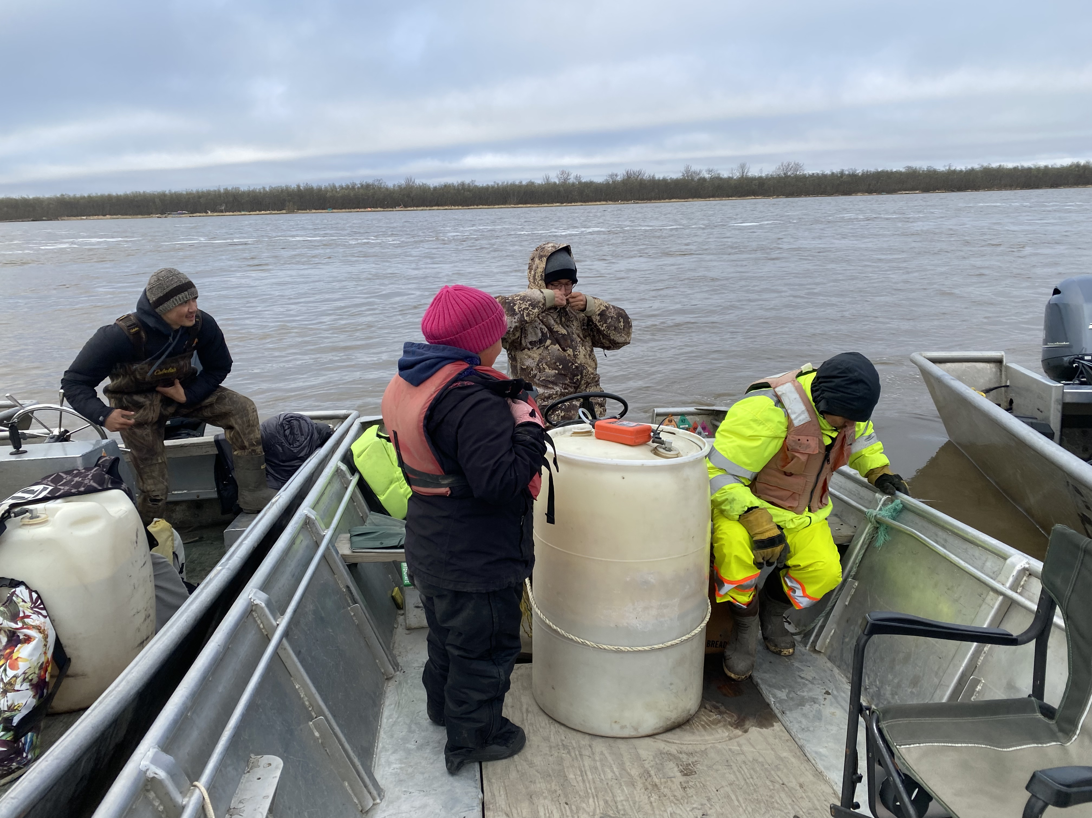

Slide 7
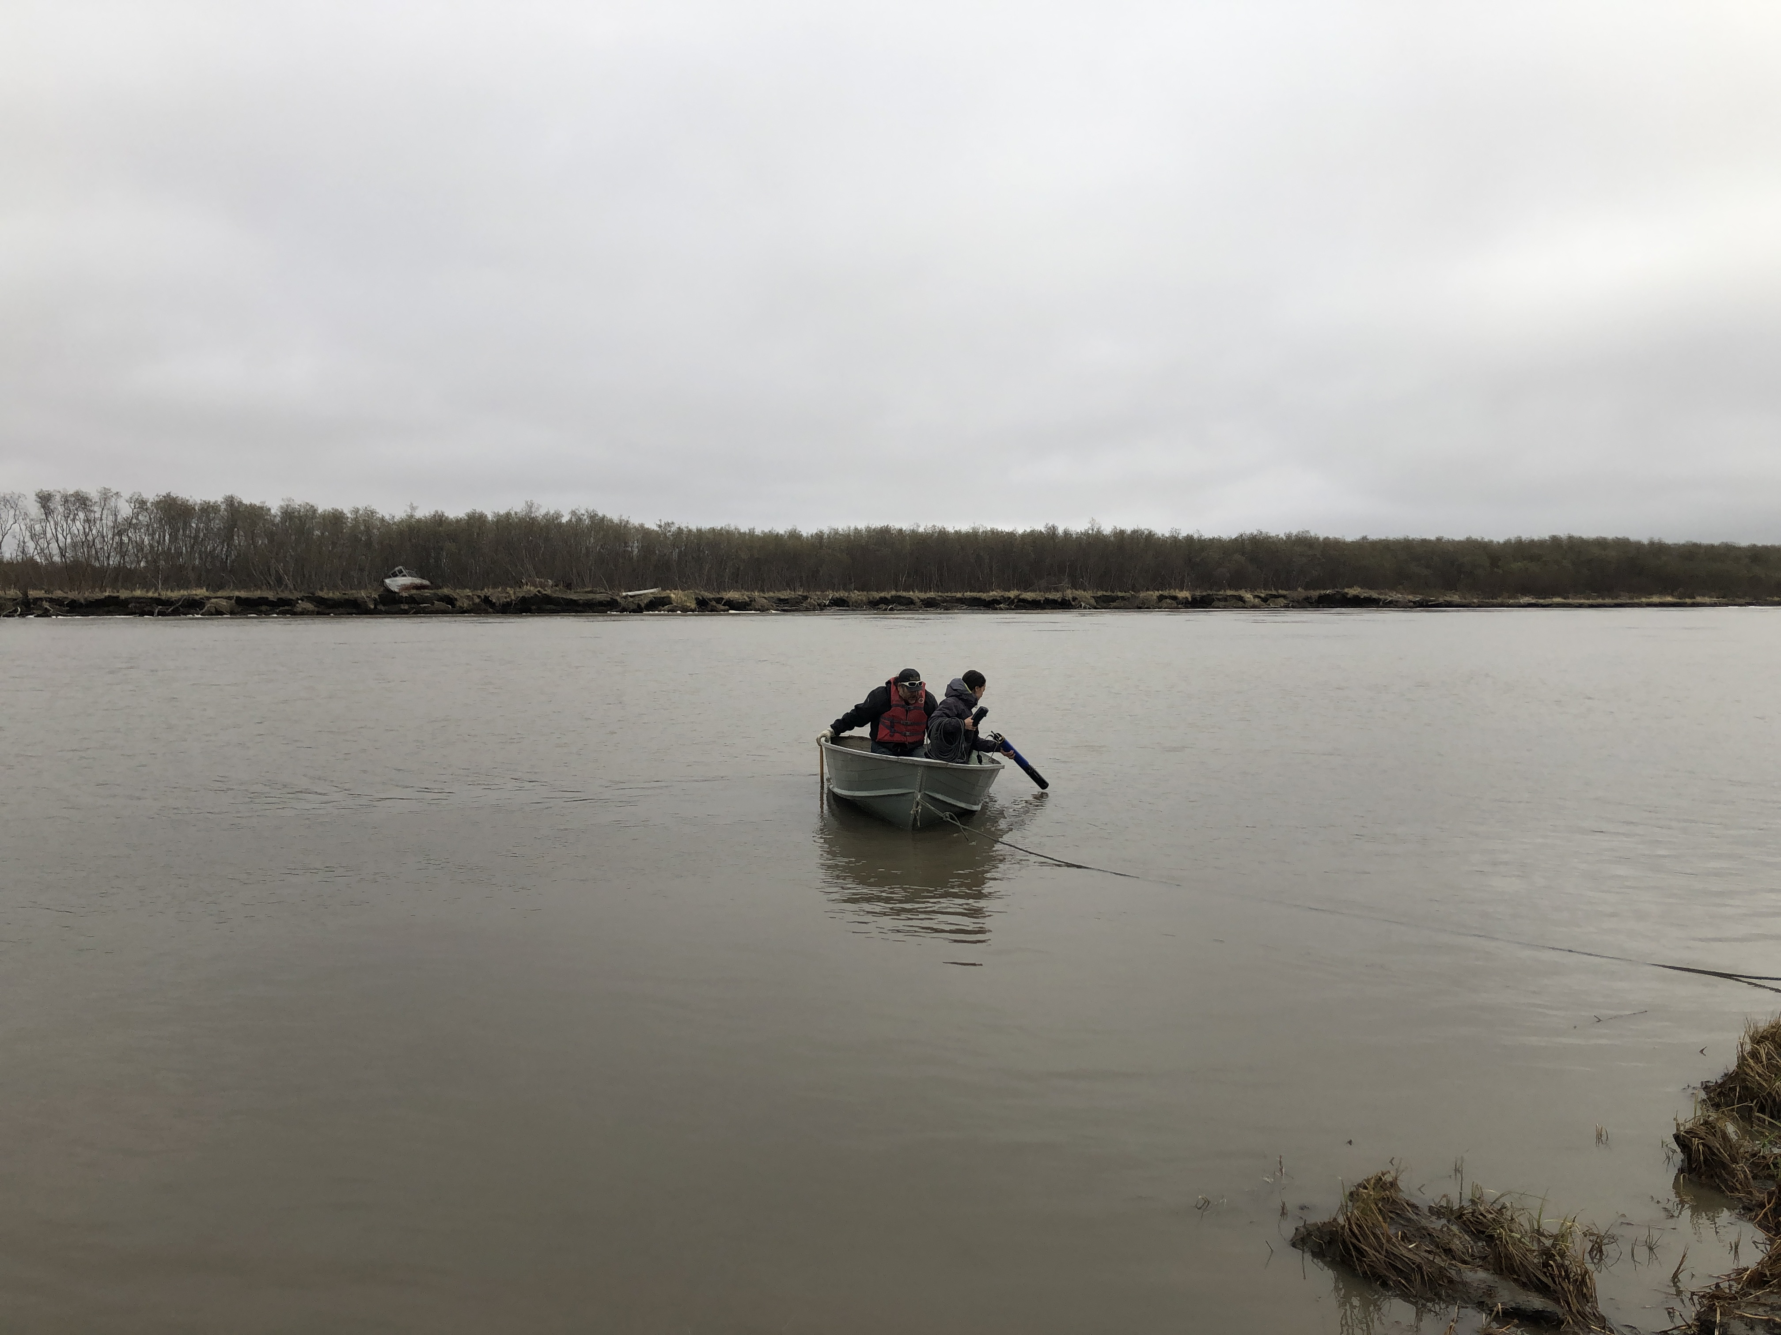
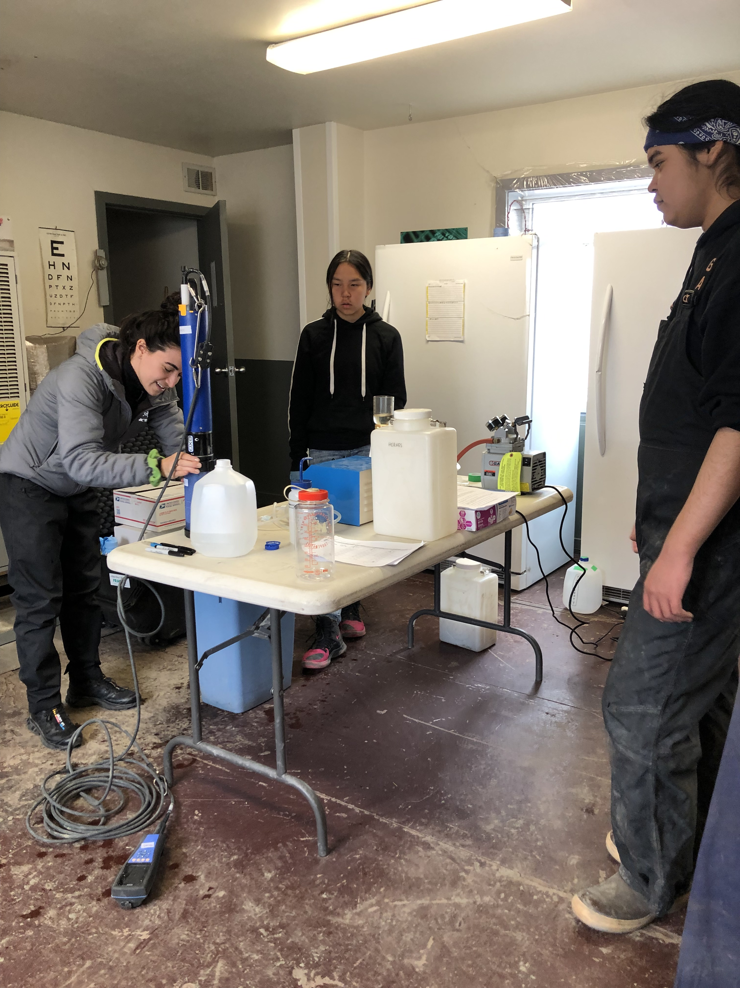
Alakanuk Interns Kiera & Theo
YSI EXO2 sonde data is being collected daily from spring-freshet through fall 2022 at the Alakanuk River Mouth.

Slide 8
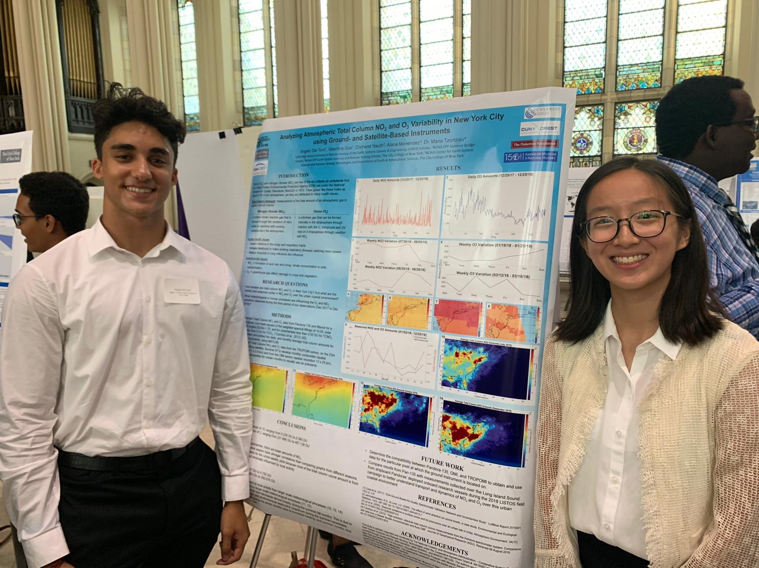
Student Skill Development
Learning background in water quality and biogeochemistry
Experience downloading, processing, and analyzing datasets
Introduction to programming
Making plots and figures that clearly convey results
Exposure to satellite data
Discussing scientific results and how this can apply to water management
Participating in project meetings with collaborators and local stakeholders
HIRES students Angelo Del Toro and Valentina Guo, 2019

