Slide 1
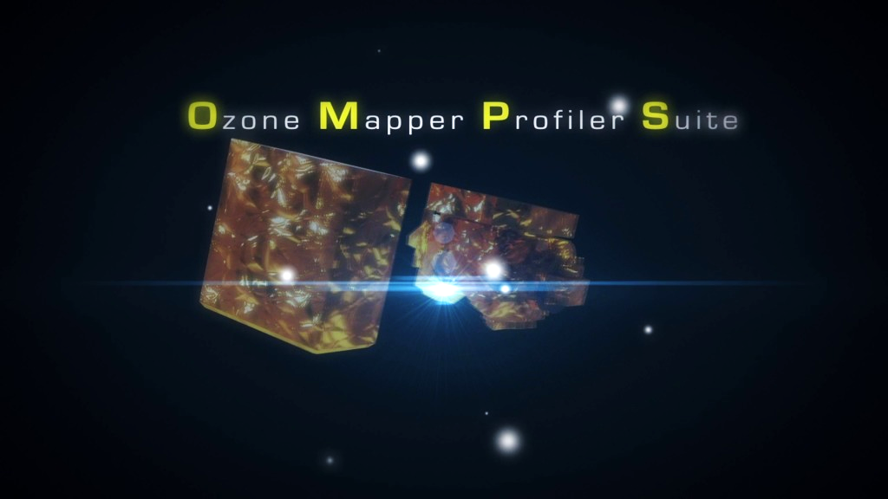
Investigation of Outlier Identification and Removal and Noise Reduction for OMPS Measurements by Using Nearest Neighbor and Principal Component Analysis
Presentation By: Dilchand Nauth, JPSS Intern
OMPS Ozone: Dr. Lawrence Flynn

Slide 2
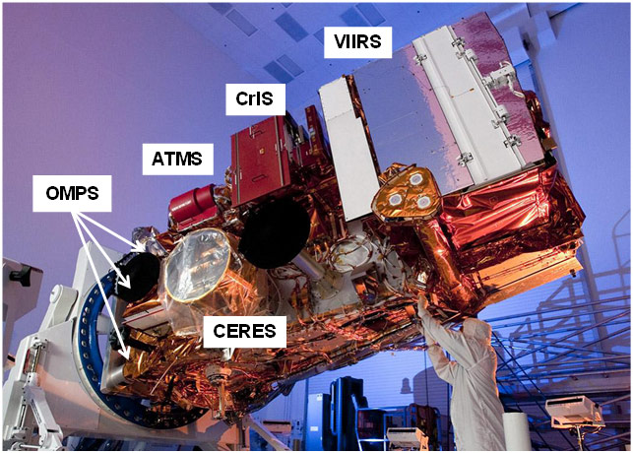
Overview
Objectives/Questions
OMPS Specifications
Viewing Geometries
Background
Phenomena
Stray Light
Ring Effect
Materials & Methods
Set Up
Initial Process
Replacement Process
Results
Comparison of NOAA-20 Data
Before and After Processes
Conclusions
Future Work
https://www.star.nesdis.noaa.gov/jpss/instruments.php

Slide 3
Objectives/Questions
Develop approaches to use the temporal, spatial, and spectral dependencies to identify and remove outliers from OMPS Nadir Mapper and Nadir Profiler SDRs.
Use the spectral patterns to develop principal component representations of the spectra to reduce noise effects in the selected channels.
When dealing with the South Atlantic Anomaly (SAA), can we fix the problems that affect our models?
Can we reduce the noise in the 12 Version 8 Total Ozone (V8TOz) wavelength channels and use additional spectral information to improve our models?

Slide 4
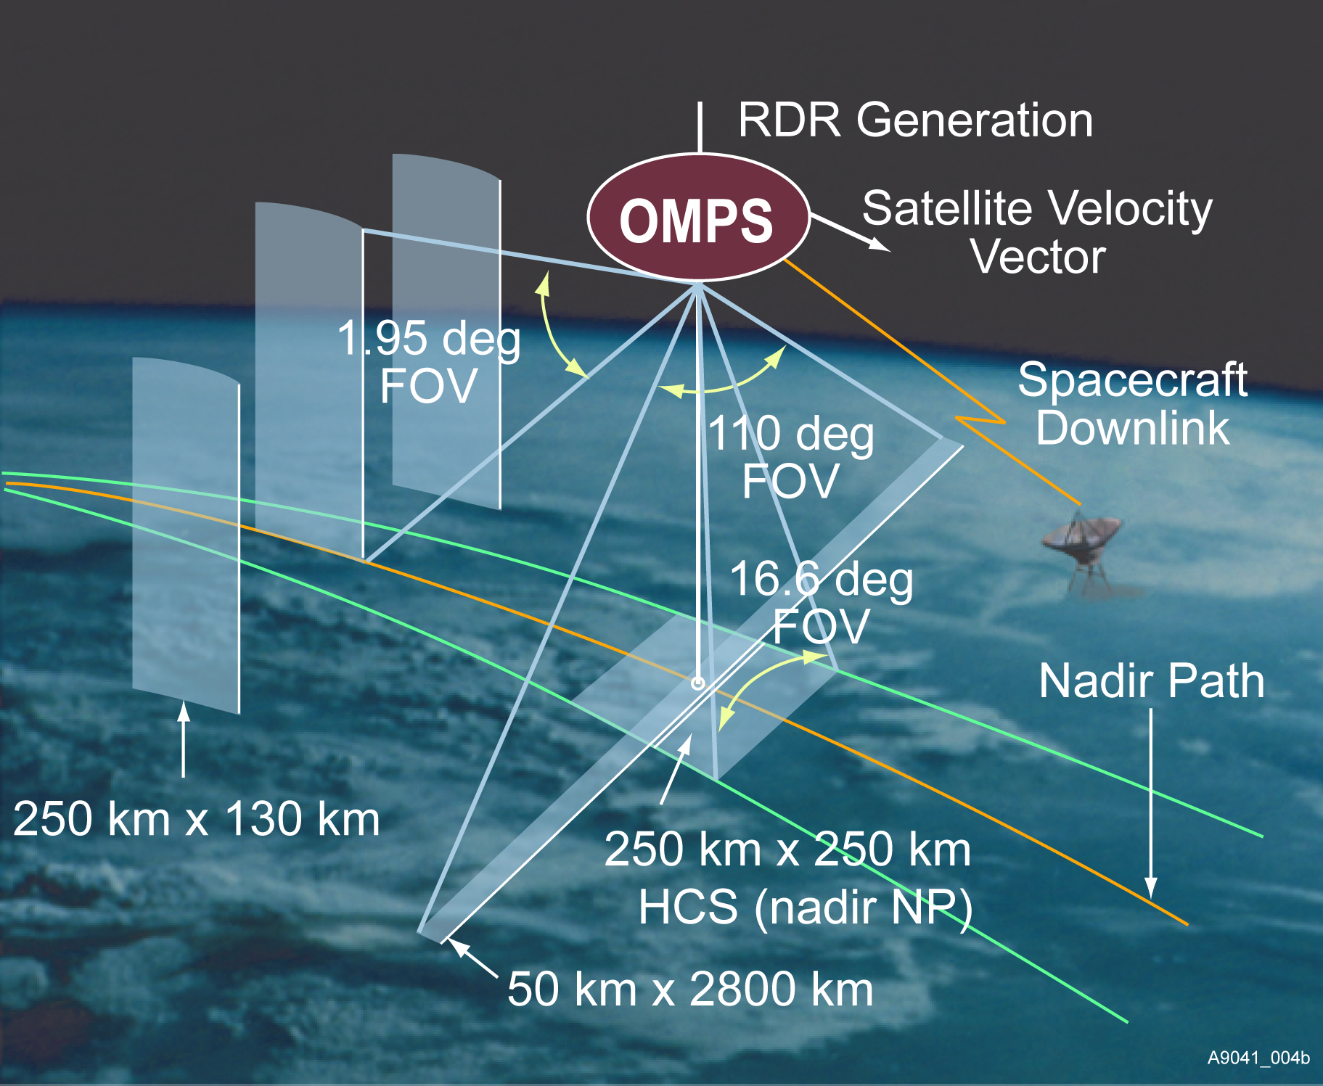
OMPS Viewing Geometries
Ozone Mapping and Profiler Suite (OMPS) measures the concentration of ozone in the atmosphere, providing information on how ozone concentration varies with altitude.
Nadir Instruments
Nadir Mapper (NM)
UV Backscatter, grating spectrometer, 2-D CCD
110 deg. cross track, 300 to 380 nm spectral
1.1nm FWHM bandpass
Products include Total Column Ozone, UV Effective Reflectivity, SO₂ and Aerosol Index Daily Maps
Nadir Profiler (NP)
UV Backscatter, grating spectrometer, 2-D CCD
Nadir view, 250 km cross track, 270 to 310 nm spectral
1.1 nm FWHM bandpass
Produces Ozone Vertical Profile, 7 to 10 km resolution
Limb Instrument
Limb Profiler (LP)
UV/Visible Limb Scatter, prism, 2-D CCD array
Three 100-KM vertical slits, 290 to 1000 nm spectral
Produces Ozone and Aerosol Optical Depth Vertical Profiles, 3 KM vertical resolution
https://www.star.nesdis.noaa.gov/jpss/OMPS.php
Provided courtesy of Ball Aerospace & Technologies Corp.

Slide 5
Background – Phenomena
Stray Light
Ring Effect
Spectrometers on OMPS are designed to measure over certain wavelength intervals and use filters and other optical elements to limit radiance from wavelengths outside the interval of interest.
Out of Band Stray Light, is a fairly smooth additive error for a given measurement over a wavelength interval.
Inelastic scattering is when incident photons interact with the molecules such that energy is either gained or lost resulting in the scattered photons being shifted in frequency.
When photons interact with molecules, there can be a third body interaction where a transitioning occurs and a quanta of energy is removed by the third body.

Slide 6
Materials & Methods – Set Up
Satellite: NOAA-20
Selected Parameters
Load a day of OMPS NM SDR data
Read in the starting and ending cross-track (0-34) and solar zenith angle (SZA) to produce desired figures
Read in the channel being used, the wavelength range, the data range, the degree of polynomial fit (2 or 3) and the number of EOF patterns desired
Cross Track (CT) : 17
SZA: 70 degrees
Wavelength Range: 350 – 370 nm
Data Range: 0 – 2000 measurements
Degree of Polynomial Fit: 2
EOF Patterns: 3

Slide 7
Initial Process
Select the radiance data in the appropriate range
-Obtain the start times
Compute the maximum, minimum and average radiance as a function of wavelength and divide by the average spectrum
-Plots the relative change from 1 pixel shift in the average spectrum
Divide each normalized spectrum by its average, find the covariance matrix
-Plots the covariance matrix
Find the eigenvectors and eigenvalues
-Plots the ordered eigenvalues and eigenvectors
Create the EOF Patterns and the corresponding coefficients
Plots the coefficients for the produced EOF patterns and shows larger outliers affecting the patterns
Build the EOF representation, restore the polynomial fit, and find the proportional EOF fit residuals
Plot the RMS residuals from the fit with neof eigenvectors
-Produces a figure showing the RMSR (root, mean, square residual) of the data with the model using the selected number of EOFs
Execute the direct fit of model (constructed variable) with a 1/avb (average) and wavelength shift patterns
-Plots the Ring Effect (direct fit on 1/avg) and the direct fit of the wavelength shift

Slide 8
Replacement Process
Replace the “bad“ values in a spectrum with model values by using a threshold on the size of the absolute value of residual
All other values will remain unchanged when this replacement takes place
Compute the maximum, minimum and average radiance as a function of wavelength and divide by the average spectrum
Divide each normalized spectrum by its average, find the covariance matrix
Find the new eigenvectors and eigenvalues
Create the new EOF Patterns and find the corresponding coefficients
Build the EOF representation, insert the polynomial fit, and find the proportional EOF fit residuals
Plot the new RMS residuals from the fit with the neof eigenvalues
-Produces a figure showing the RMSR (root, mean, square residual) with the model using the selected number of EOFs
Execute the direct fit of the model (created variable) with a 1/avb (average) and wavelength shift
-Plots the Ring Effect (direct fit on 1/avg) and the direct fit of the wavelength shift

Slide 9
Results

Slide 10
Figure Left: Shows some features and spikes along the average spectrum at a given wavelength with no filtering applied. Figure Right: Relatively the same features as the original plot, but there could be corrections that are not noticeable.
Replacement Process
Initial Process

Slide 11
Figure Left: More bumps and spikes in the covariance matrix suggest that there is some bad behavior (outliers) within the data. Figure Right: Relatively the same as the original covariance matrix.
Replacement Process
Initial Process

Slide 12
Figure Left: Focusing on the 4 immediate eigenvalues (between 0-5 pixels) there is a drop between each of them moving left to right, with respect to each other. Figure Right: These eigenvalues look similar to the original eigenvalues, but observing the eigenvalue located at the 4th pixel, it has been shifted slightly after the replacement of values has been applied.
Replacement Process
Initial Process

Slide 13
Figure Left: Patterns can be combinations of straylight and wavelength shift, making them more difficult to analyze. Note that everything must be orthogonal to each other. The 1st pattern shows some interesting behavior happening between 357 - 360nm. Looking at the rest of the patterns, there might be some big outliers influencing the behavior of the signals due to the various spikes that can be seen. Figure Right: The 4th, 5th, and 6th patterns have been corrected for large outliers. The most visually notable correction is the 5th pattern, where the large down in the signal at 352 nm and 358 nm, respectively, have been corrected for.
Replacement Process
Initial Process

Slide 14
Figure Left: The 1st and 2nd coefficient shows orbital variation related to wavelength shifts and stray light or Ring effect. The 3rd pattern is a little more difficult to interpret, possibly due to stray light. The 4th, 5th, and 6th coefficients contain visually large outliers that suppress the rest of the coefficient. Figure Right: The first three coefficients look the same as the original. The 4th, 5th, and 6th coefficients have been corrected for and more recognizable patterns emerge.
Replacement Process
Initial Process

Slide 15
Figure Left: The behavior of this signal shows that there is an outlier at 358 nm. The spike at this wavelength is bigger than 1.0% relative to the model fit. Figure Right: The signal compared to the original has significantly improved. The error at 358 nm has been reduced roughly or less than 0.4%. This can be considered to be a nosier signal rather than a signal dominated by bad behavior.
Replacement Process
Initial Process

Slide 16
Figures: This effectively is informing us about the impact of stray light or the ring effect. Looking at the retrieval algorithm, there would be clouds detected in some locations and these would correlate with the cloudiness and other various occurrences, where there is a brighter or darker scene.
Replacement Process
Initial Process

Slide 17
Figures: This indicates that there is an orbital pattern and shows the shift relative to chosen measurements. Note that the EOFs are only determined up to a sign meaning that the sign is not determined during the process, therefore, the wavelength shift could be positive or negative.
Replacement Process
Initial Process

Slide 18
Conclusions
NOAA-20 makes 3x as many measurements compared to S-NPP. Each measurement has 1/3 the data going into it, so if the noise is Gaussian distribution we’d expect that the noise levels would increase by a factor of the square root of 3. If the noise is outlier statistics, we’d expect the noise to increase by a factor of 3. This data will have nosier patterns, however, they can be reduced.
To remove large outliers that suppress patterns, we replaced the bad values with the models values without changing the defined variables. This is effective for large outliers.

Slide 19
Future Work
Apply an efficient filter that will eliminate spectra with bad values from the dataset and track how many fewer spectra there will be, relative to outlier removal.
The ‘Nearest Neighbor’ outlier identification method is an appropriate way to detect bad behavior that influence the patterns that we receive, but it has yet to be implemented. We could apply this method at the beginning of our algorithm to effectively see what values will influence our results.
Automate the process of identifying and removing all outliers that affect our models.
SO₂ Ioading is relatively small globally so it may not be included in the EOFs. Volcanic eruptions produce more SO₂ and this can be troublesome for our models. Because significant SO₂ loading is not frequent in our data, we need to find a way to include more data into our signals, such that our patterns can include these SO₂ absorption patterns.

Slide 20
Acknowledgements
Thank you to Dr. Lawrence Flynn and his team for giving me the opportunity to experience and assist on their research and the exposure of handling data from S-NPP and NOAA-20 OMPS Satellites!
Thank you to Dr. Mike Wilson for assisting me with retrieving the appropriate data for the models and coding dilemmas faced throughout the project!

