Slide 1
STUDY OF LOCATION ERROR IN SATELLITE PRECIPITATION ESTIMATES USING A RADAR-GAUGE PRODUCT
Kibrewossen Tesfagiorgis, PhD, PE
Science Department, BMCC-CUNY

Slide 2
Why study Precipitation?
Only Few percentage of water on earth resides as Fresh
Only few fraction of that is accessible
Most of the fresh water we are drinking is coming from Precipitation
Helps us to characterize
  Drought
  Flood- one major flood per day somewhere in the world
Understanding snowfall is important for:
  Transportation
  Safety
  How much freshwater is available
Next Question is:
How can we study/measure Precipitation in a larger scale?

Slide 3
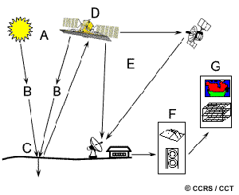
Fundamentals of Remote Sensing

Slide 4
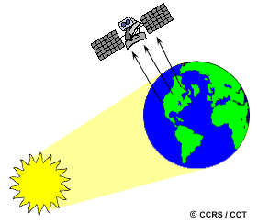
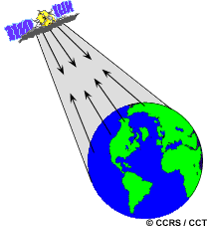
Active and Passive Sensing
Active
Passive

Slide 5
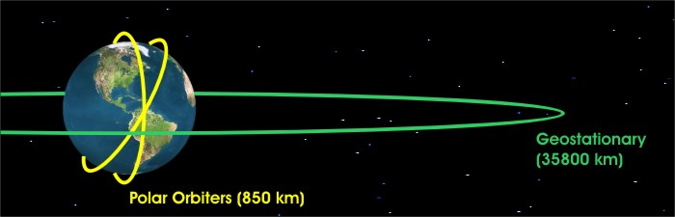
Polar and Geo-Stationary Satellites
https://www.e-education.psu.edu/eme810/node/477

Slide 6
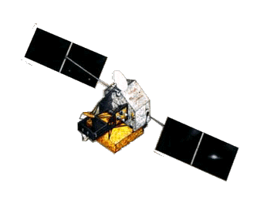
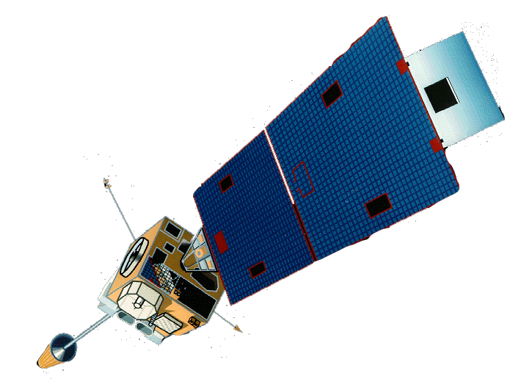
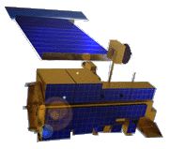
Precipitation Acquisitions, examples
TRMM
GOES
NASA
EOS
TMI, PR, VIRS
VIS, NIR, IR
SOUNDING
MODIS VIS, NIR, IR
ASTER, CERES
Precipitation
Radar
Gauge
More is coming

Slide 7
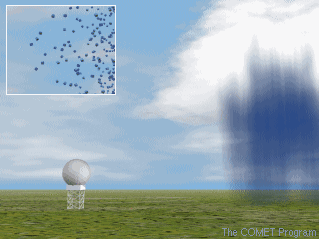
Radar Precipitation
Better than Satellite estimates
Blockage problem:
Missing or Underestimated Precipitation depending on the percentage of blockage
−1º < α < 60°
Blockage
α

Slide 8
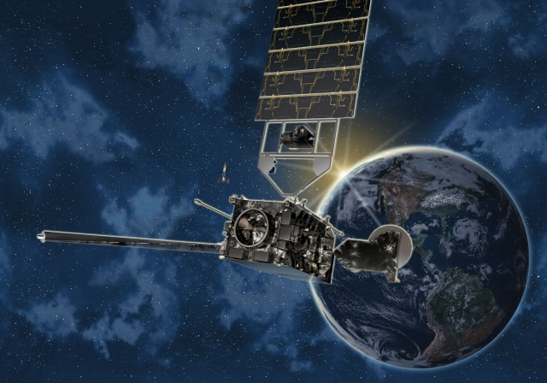
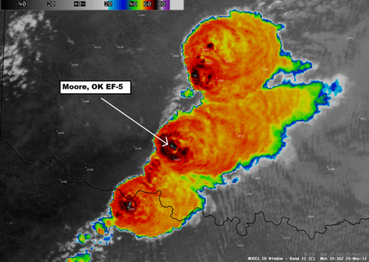
Satellite Precipitation
GOES-R
An EF-5 tornado event in Oklahoma as seen by a satellite infrared image

Slide 9
What is the issue we are investigating?
GOES-R

Slide 10
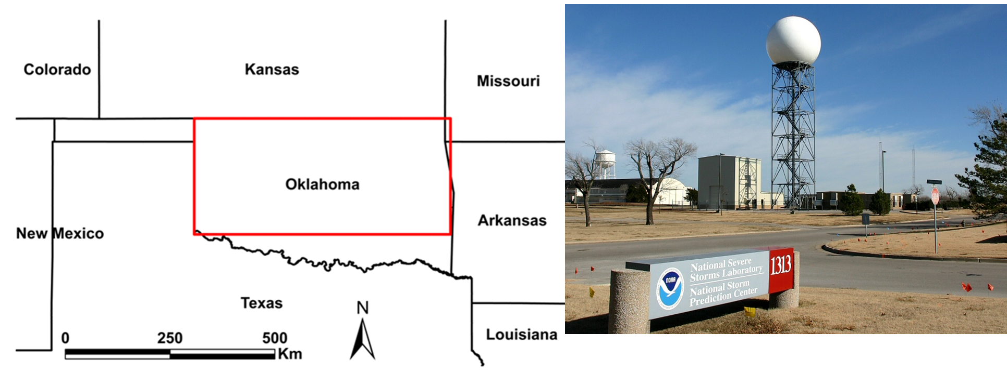
Study Area and Data
IR based Satellite estimates
Radar-gauge
Hydro-Estimator
SCaMPR
QMorph
Versus
Radar-gauge Stage IV

Slide 11
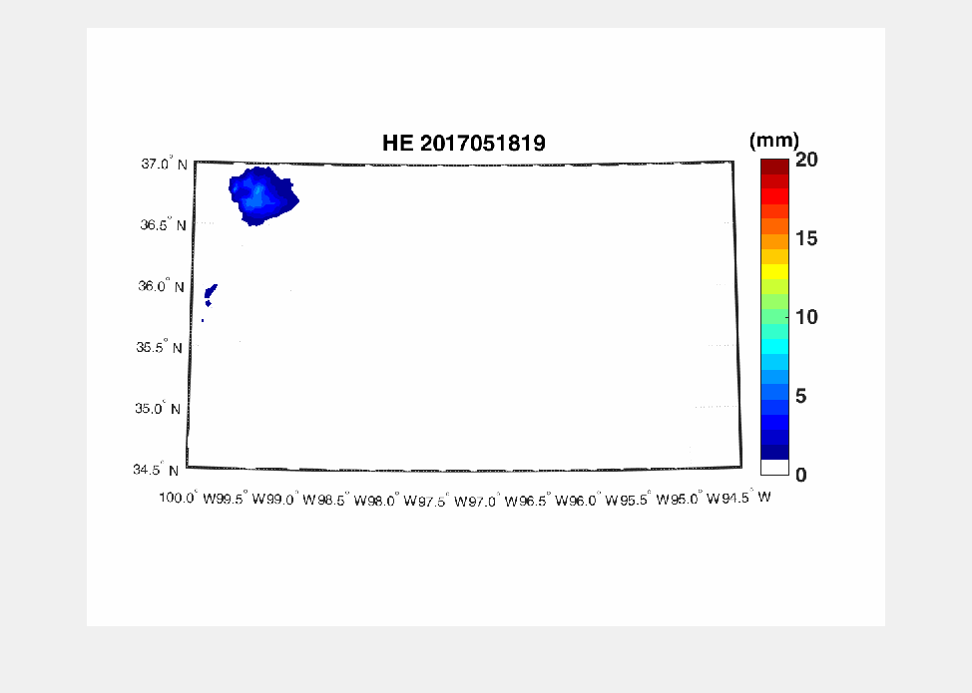
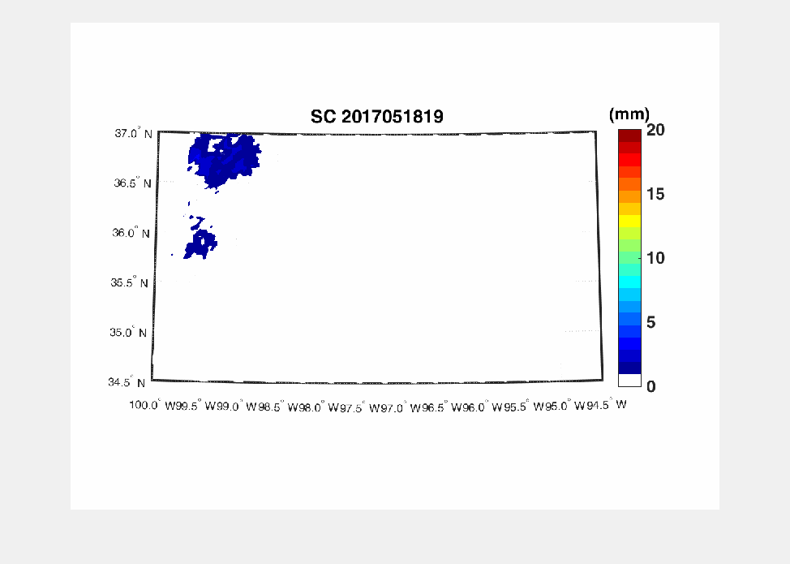
Precipitation comparison
Tornado Cases
Well defined precipitation structures
Easily identified by both satellite and Radar observations
We will be using Matlab and R
https://www.youtube.com/watch?v=CR-QSH1qIMk

Slide 12
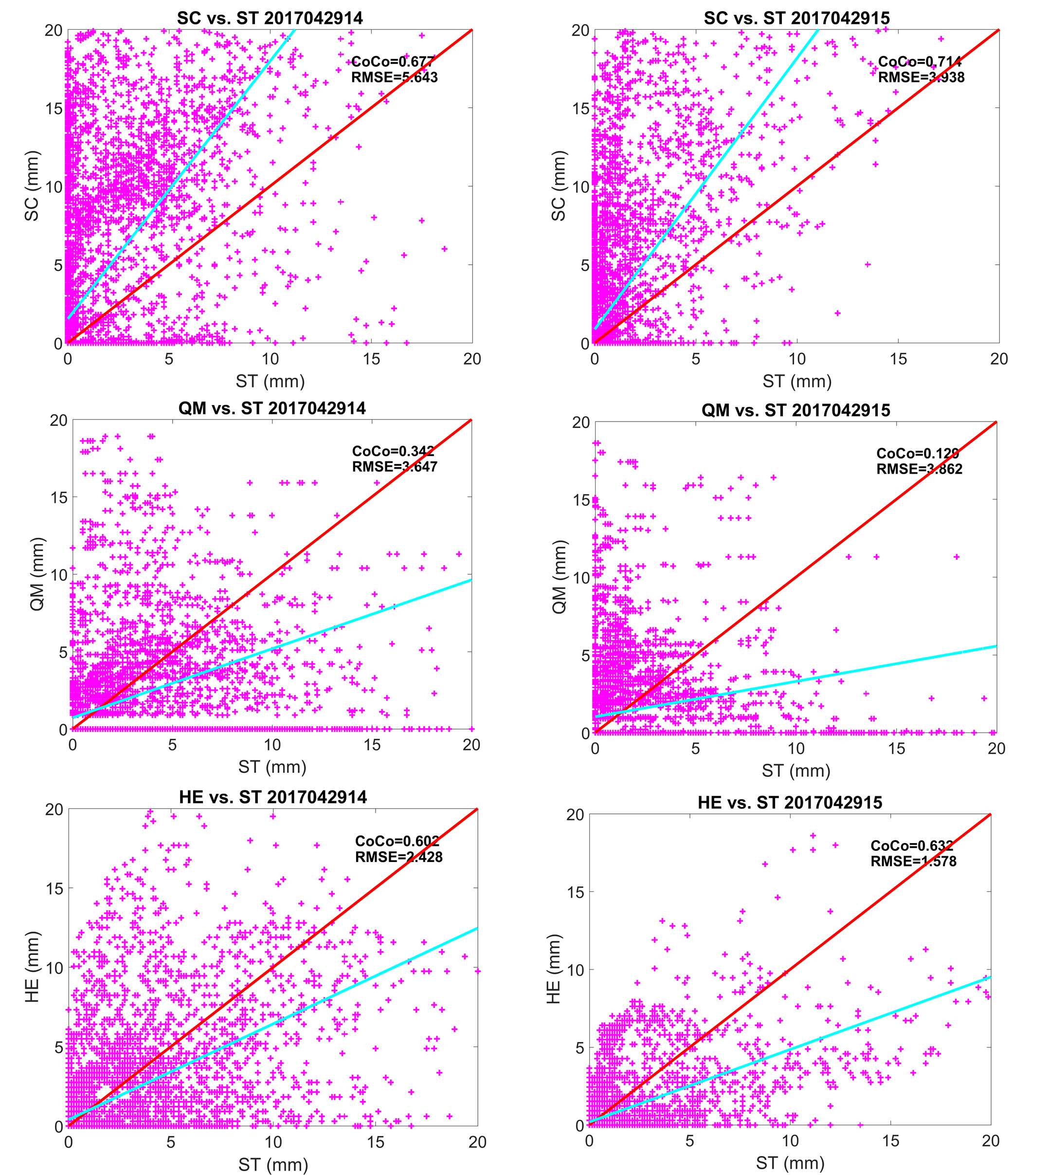
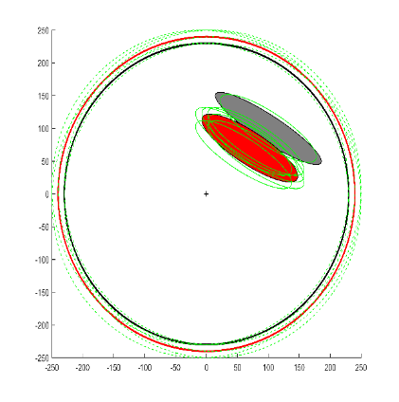
Schematic demonstration of the overall methodology. The solid black and red circles represent the radar umbrella and satellite region of interest respectively. The broken green lines represent the movement of the red solid line. The grey and red ellipses represent radar and satellite precipitations within the region of interest. The green ellipses represent the movement of the satellite precipitation estimate. The cross is the location of the radar.

