Slide 1
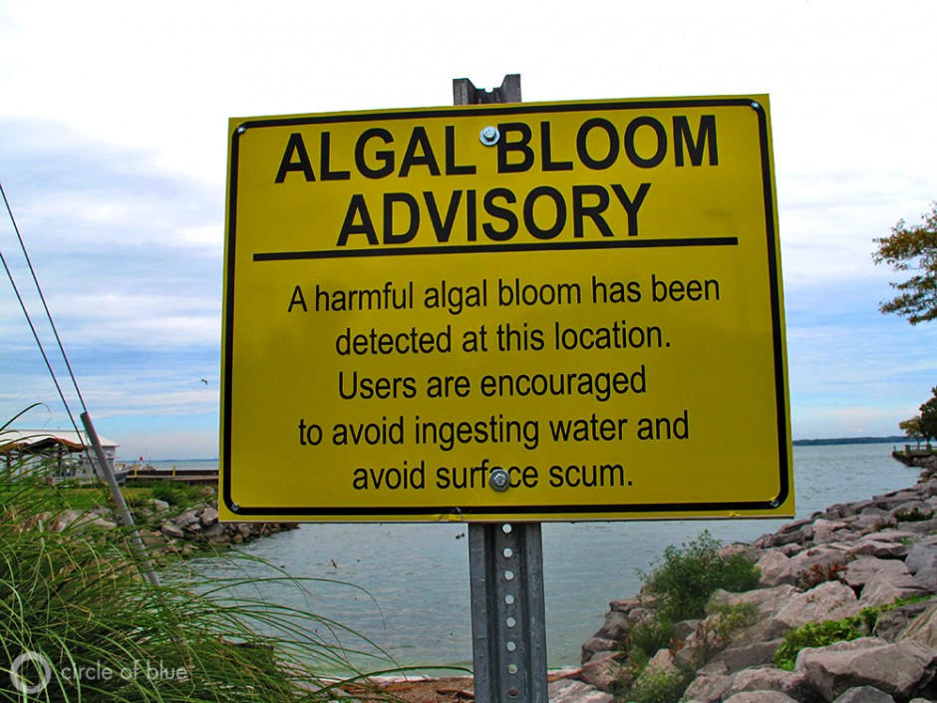
Background of harmful algal blooms (HABs)
Algae—simple plants that live in the sea and freshwater.
Harmful algal blooms, or HABs, occur when colonies of algae—grow out of control while producing toxic or harmful effects on people, fish, shellfish, marine mammals, and birds. The human illnesses caused by HABs, though rare, can be debilitating or even fatal.
In united states alone it has been estimated that $30-$70 million is lost annually as a result of HABs (Fisher et al., 2003).

Slide 2
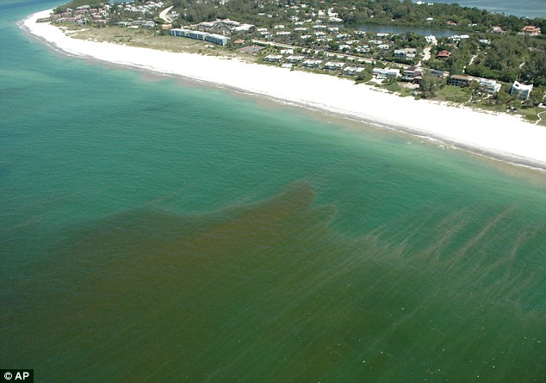
Background of KB HABs in West Florida shelf (WFS)
Approximately 5,000 species of phytoplankton, only about 300 of them could cause color change.
We will be studying Karenia Brevis blooms (KB HABs), in West Florida shelf (WFS) area, which occur nearly every year and can cause color change.
Ocean Color reflectance (Rrs) is observed in the visible portion of spectrum (390 to 700nm) RGB
(KB HABs)
Kareina Brevis, Harmful Algal blooms
present nearly every year in Florida
Decrease in Rrs(λ) for KB blooms would cause the water to appear darker since the green reflectance peak at 570 nm is less (green, olive green, black “darker” with high algae concentration). Although a red reflectance peak (~685-700nm) due to algae florescence becomes increasingly, KB blooms do not appear as red in color visually as they do radiometrically because receptors of the human eye are only slightly sensitive to this portion of the visible spectrum.

Slide 3
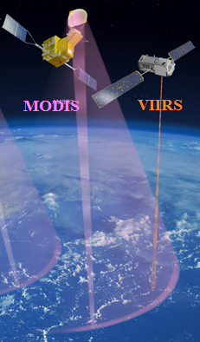
MODIS & VIIRS satellites capability for KB HABs detections
MODIS satellite
Uses Rrs 678
For KB bloom detection
VIIRS

Slide 4
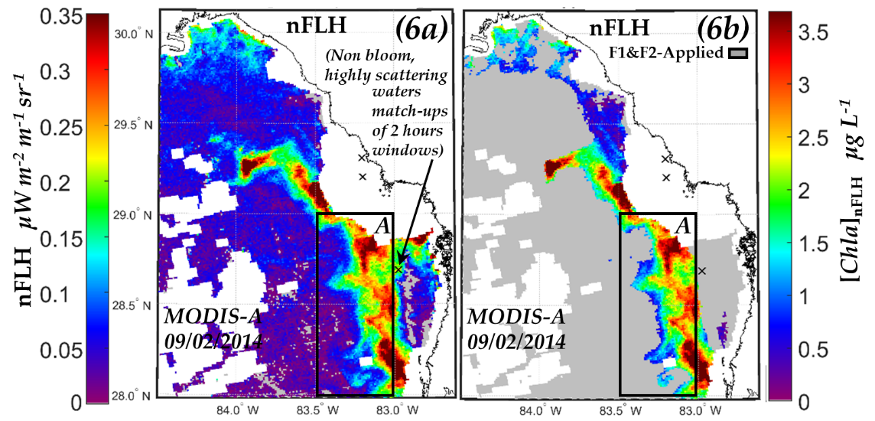
Example of KB blooms Detection from MODIS Satellite image
West Florida Shelf

Slide 5
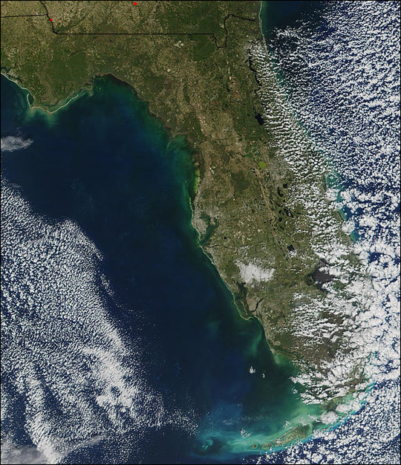
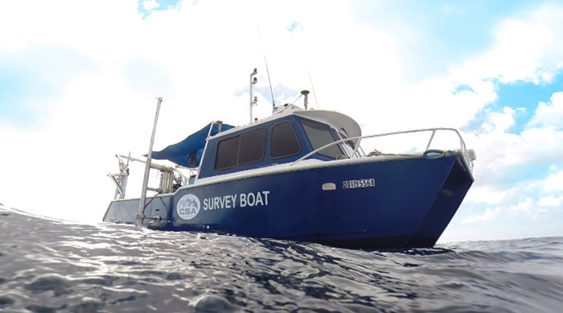
Satellite measurements
Area of study:
(West Florida Shelf)
Field measurements

Slide 6
The goal of Harmful algal bloom KB HAB project is
To have an effective KB HAB, detection and tracking approach for use with satellites (VIIRS) without the availability of fluorescence channel.
So that NOAA can extend its HAB monitoring capabilities to VIIRS and continue to support local authorities in their forecasting of beach conditions, including health warnings etc.
In this project we will investigate and compare the potential for satellite detection.
Examine the temporal change of harmful algal blooms from consecutive satellite imagery.
We will be using Matlab, SeaDAS and Giovanni software's.

